Slide 1
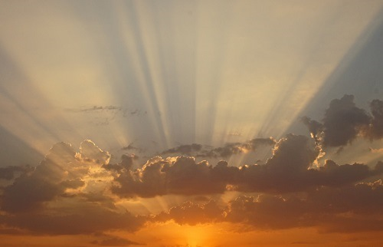

Day-start in Exodus 12
Notes dec 16/20: - ready for kim to approve - again.
no pdf concerns now: -- slides 16 & 65 are completely redone – the cartoon slides..
Kim, all your email suggestions have been worked on. I removed the questionable slides on the events of Passover and saved at the end. I don’t think we need them. All the other changes have comment boxes. So, just go through and check everything. I have not had time to do that yet. Today was another busy day with things not scheduled at all. Give me your feedback – sorry this is so late. I’ve been working on this since morning – lots of phone call interruptions today. That’s all for now. Charlene 535 pm Dec 16th
Notes:
Given by Kim Phelps on Dec 19/20 at CCC – very well done.

Slide 2
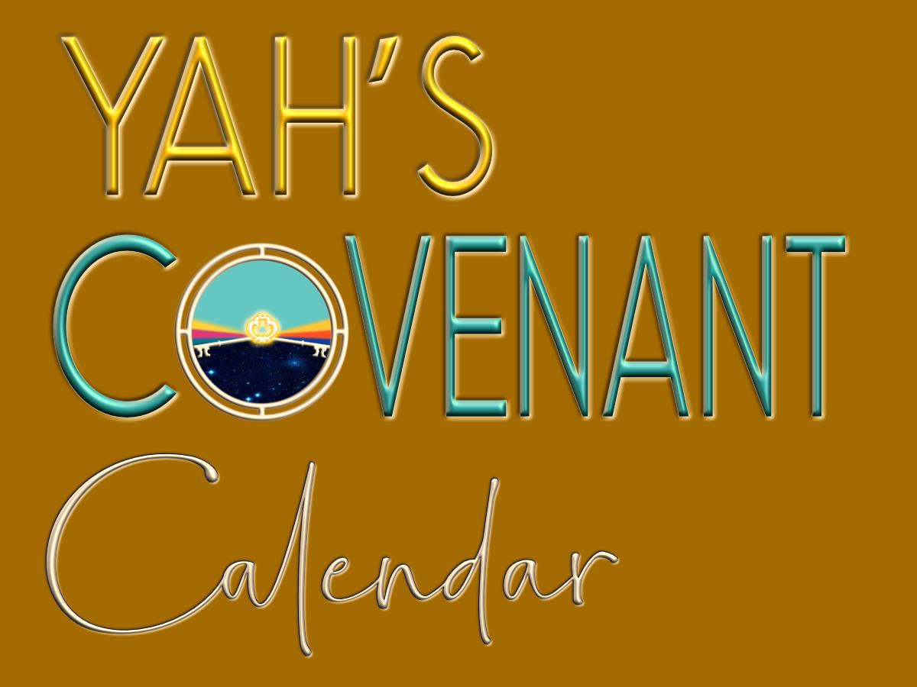
A TEACHING FROM Exo 12 &
Visit: studythecalendar.com

Slide 3

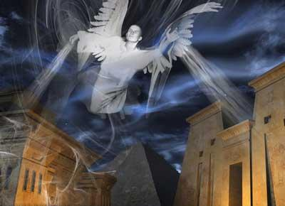
Exodus 12
Egypt’s
Passover
Let’s begin with an overview.

Slide 4
Exodus 12:1-51 Passover Instituted
This is a long chapter, with very explicit instructions about requirements for the Passover Feast Cycle.
Not every verse can be applied to every Passover that follows.
  Vss 1-5: Select a lamb on the 10th day and keep it
  to the 14th day;
  Vss 15-20: Instructions for the 7 cycles of the
  Feast of Unleavened Bread;
  Vss 24-28: Observe Passover as a memorial forever;
  Vss 35-36: Egyptians had been spoiled;
  Vss 37-39: Leaving Rameses (we’ll actually find out when);
  Vss 40-42: Addresses the 430 year timeline since Abram;
  Vss 43-51: Passover Regulations of who can partake;
Less than half of the 51 verses address the actual event of the Passover from Egypt. We will look at these verses closely.

Slide 5

Study Outline For Exodus 12
1st Witness: Address the Divine commands for Passover Feast cycle as given in this chapter. (Examination of Sunset/Dawn Charts inclusive.)
2nd Witness: Rabbinical Sunset Mindset
3rd Witness: 2 Chron 35 – King Josiah’s Passover
400/430 year timeline comparison between Gen 15 with Abram and the Exo 12 Passover Deliverance
Spoiling the Egyptians

Slide 6

Conflict Between Verses?
Verse 10 gives explicit instructions that if any
portion of the lamb will be remaining until
the morning, it has to be burned with fire.
For obvious reasons, this disposal would
not be done inside their dwelling place.
In verse 22 instructions are given for the people to remain
in their homes till morning.
How would this be accomplished if lamb leftovers must be burned before morning and they are commanded “not to go out their door until morning”?
We know the homes of the people during the Exodus 12 timeframe were not like ours. Let’s examine some examples
of what their living quarters may have been like.
https://www.mystudybible.com/api/content/578777BC-2B02-48A6-8F1C-A4FB50319CBB/page_2927.xhtml

Slide 7
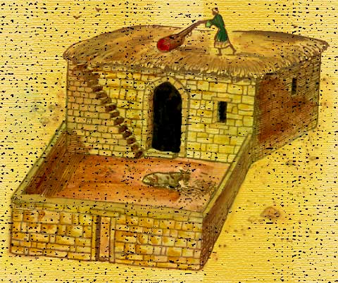
A Typical Home of the Israelites
The homes of the poor were small
and modest, consisting of usually
one to four rooms, and almost
always including a courtyard on
the east of the house so that the
prevailing westerly winds would blow
the smoke away from the house.
The family carried on most of its activity in the courtyard.
Food was prepared here in an oven built of clay.
Storage jars were kept here, and animals were often housed here. However, the house only met the essential needs of family life such as shelter, a place to prepare food, make clothing and pottery, care for animals, etc.

Slide 8
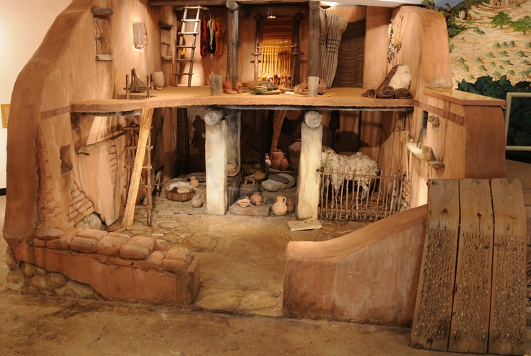
A Typical Home of the Israelites
Social life was normally
conducted at the community
well or spring, the city gate,
the marketplace, or in the fields
at work. Because of the heat in
summer and the cold in the
winter, houses were built with
few, if any, windows. This also
provided more protection from intruders, but it meant that the houses were dark and uninviting. The only escape from the dim, cramped interior of the house was the courtyard and especially the flat roof. Here, the women of the house could do many of their daily chores—the washing, weaving, drying of figs and dates, and even the cooking.

Slide 9
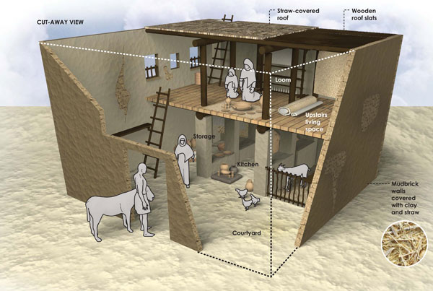
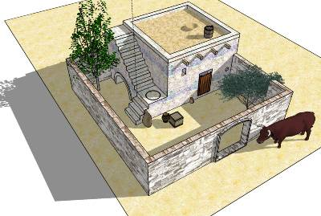
A Typical Home of the Israelites
Reconstruction of an eighth-century BC Israelite house showing rooms
for sleeping on straw
mats and for storage.
The outer courtyard was used for food preparation, cooking, and to house
small animals.
Construction of houses did not change much until the New Testament period.
This was a typical pattern for the average home of the Old Testament period.

Slide 10
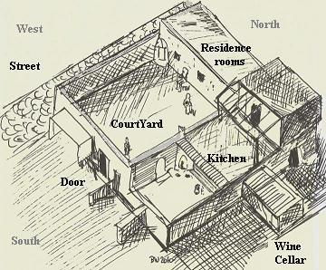
A Typical Home of the Israelites
Here is an aerial view focusing on the gate area, (provided by courtesy of the excavations director
R. Arav).
In the center of the picture is the four-chamber inner gate.
The rooms of the house were located around a central courtyard, which had
a water cistern.

Slide 11
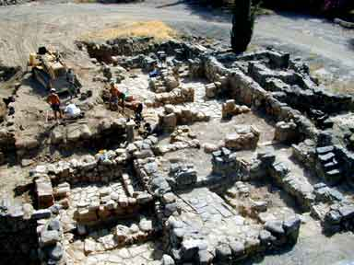
Excavation Site of a Typical Home

Slide 12
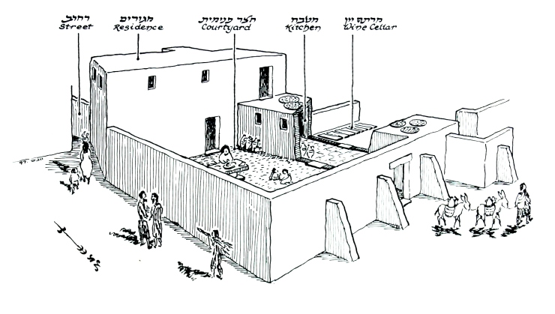
A Typical Home of the Israelites
Note: All the homes had a “courtyard” area that would serve as the area to burn the remainder of uneaten lamb outside of the living quarters, but still not be located outside of the main “door” entry of the dwelling area for their family and animals.
Artist's rendering of a courtyard style home in Bethsaida (designed from a photo of an actual excavation site).

Slide 13
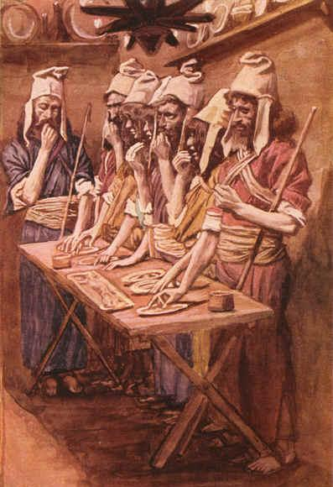
Clarification for the Term Passover
Passover has many definitions such as:
Passover [Spring] Festival – 8 days including Passover Day, 7 days of Unleavened Bread & Wavesheaf.
Passover Feast – one complete cycle of 24 hours, celebrated on the 14th cycle of the 1st month.
Passover Lamb – the sacrificial animal offered, eaten and left-overs disposed of on the 14th cycle.
Passover Meal – commanded to be eaten on the Passover Festival cycle. They were also commanded to eat unleavened bread and bitter herbs with this meal. (Exo 12:8)
What about the Angel that passed over at midnight?

Slide 14
Questions About Passover
Are we sure that all of the events connected to Passover actually happened on Passover Day? Does it matter?
Was the Passover Day ever referred to as the Feast of Unleavened Bread?
Does eating unleavened bread dictate the Passover meal will be part of the 1st day of Unleavened Bread?
Or … is the Passover meal always eaten on the 14th cycle – at the Passover Feast?
Yahuah’s people, covered under the blood of the doorposts were safe from the Death Angel.
Did this Angel “pass over” the blood stained homes at midnight of Abib 14,
or Abib 15?
Does the Passover Day begin with a sunset moment? If not, what is the function of sunset?

Slide 15
1st Witness:
Study Outline For Exodus 12 on the Divine Commands For Passover
Examination of Dawn/Sunset Charts

Slide 16



So, When Is Passover?
Note: A random date for Passover was chosen.
Hey, everyone … Passover is on
April 3rd this year.
Meet you there!
Does that mean Passover starts at sunset on April 2nd?
No … I think that means sunset on
April 3rd, doesn’t it?
This is the kind of confusion that results from the sunset day mindset.
We’re going to examine 3 witnesses
to solve the day-start question:
Exodus Passover with Moses
Jewish Historical Account
King Josiah’s Passover

Slide 17
Let’s read Exodus 12:1-10 (Context: 1st Month & 10th Cycle)
And Yahuah spake unto Moses and Aaron in the land of Egypt, saying,
This month shall be unto you the beginning of months: it shall be the first month of the year to you.
Speak ye unto all the congregation of Israel, saying,
In the tenth day of this month they shall take to them every man a lamb, according to the house of their fathers, a lamb for an house:

Slide 18
Exodus 12:4-5 (Context: 1st Month & 10th Cycle)
And if the household be too little for the lamb,
let him and his neighbor next unto his house take
it according to the number of the souls; every man according to his eating shall make your count for the lamb.
Your lamb shall be without blemish, a male of the first year: ye shall take it out from the sheep, or from the goats.

Slide 19
Exodus 12:6-7 (Context: 1st Month & 14th Cycle)
And ye shall keep it [Passover lamb] up until the fourteenth day of the same month: and the whole assembly of the congregation of Israel shall kill it
in the evening. [H6153] …
And they shall take of the blood, and strike it on the two side posts and on the upper door post of the houses [Context: 14th Day], wherein they shall eat it.

Slide 20
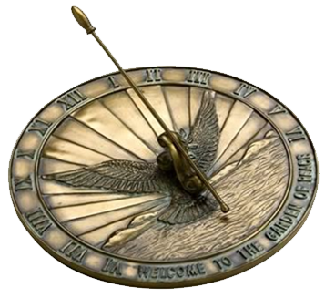
Strong’s DEFINITION FOR EVENING:
<`ereb> H6153
evening <`ereb> (H6153) [1] dusk, [2] day,
[3] even (-ing, tide), [4] night.
DUSK (Webster’s 1828 Dictionary) – a middle degree between light and darkness.
TWILIGHT (Webster’s 1828 Dictionary) –
The faint light, which is reflected
upon the earth after sunset
and before sunrise.
[Day and/or Night are not a
mixture of light and darkness.]

Slide 21
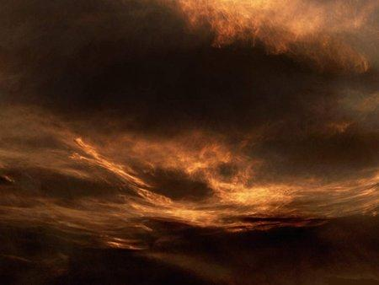
Exo 12:6 uses the term
“between the evenings” (Beyn ha Arbayim).
These Hebrew words are first used in Exodus 12:6.
“And ye shall keep it up until the fourteenth day of the same month: and the whole assembly of the congregation of Israel shall kill it <H996 – Beyn>
in the evening <H6153 – Arbayim>.”
What does this phrase really mean?

Slide 22
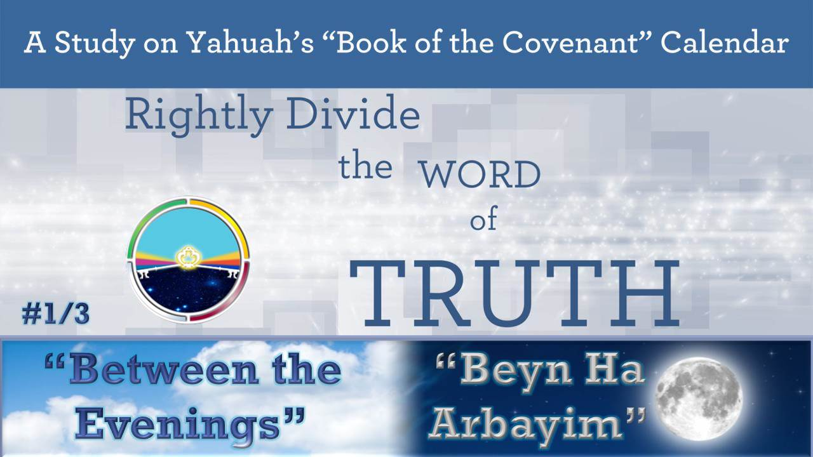
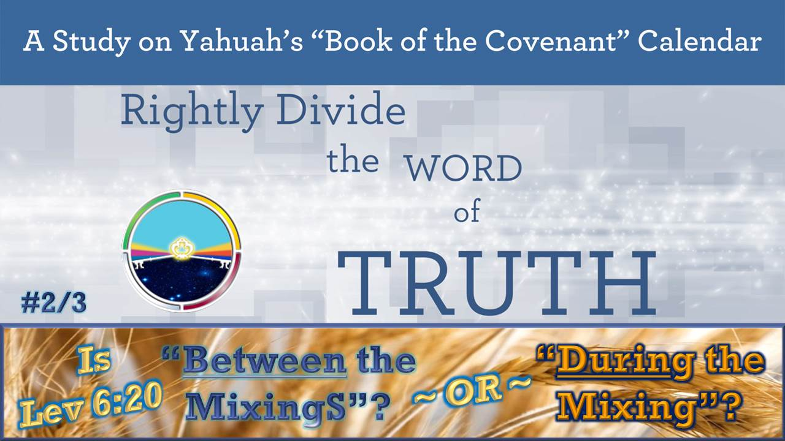
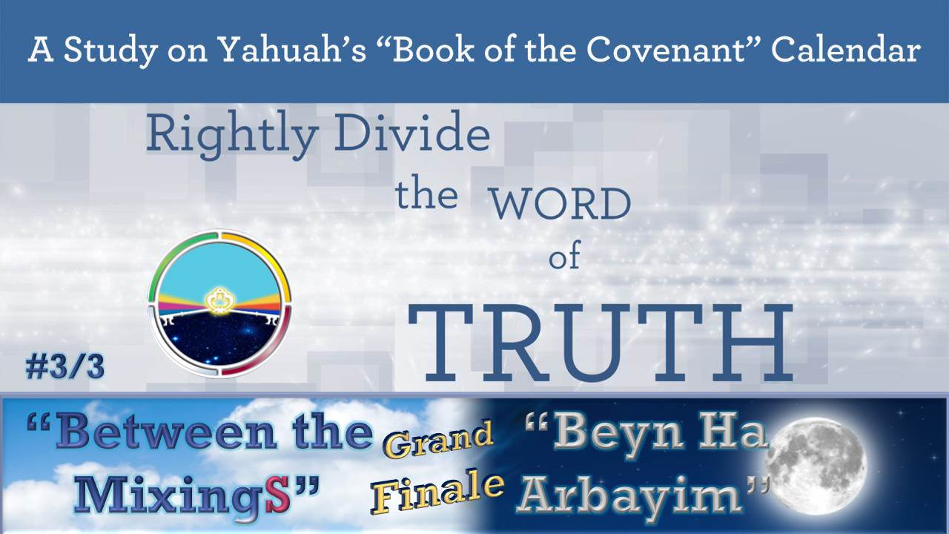
There are 3 teachings
available to fully
understand the phrase
“beyn ha arbayim” @
www.studythecalendar.com
This study will have only a brief summary.

Slide 23
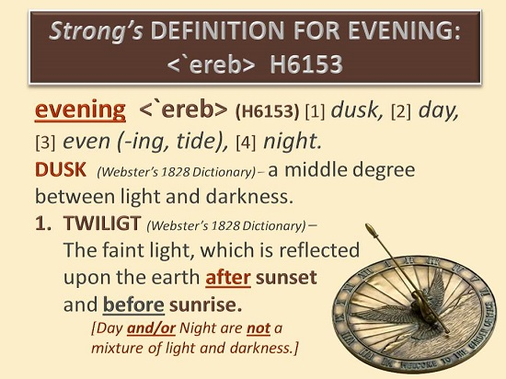
The Hebrew definition of “evening” should be fairly easy to understand.
But do all Messianic and Hebrew Roots teachers agree with the Hebrew?
Remember, the 1st definition is “dusk” or
a mixing of light & night
after sunset!

Slide 24
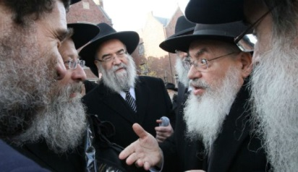
The 1st Hebrew definition for “evening” is “dusk” (after sunset).
Popular DEFINITION for EVENING
(According to the Rabbis!)
The most popular Rabbinical definition is:
the “evening” begins at noon, ending at sunset –
defining the 9th hour as “between the evenings”
or “between noon & sunset” to align with Yahusha’s death.
Yahusha did lay down His life at the 9th hour. However that is according to one of the Hebrew definitions, for the timeframe of “between the evenings.” Both “dusk/dawn” are “mixings” derived from 2 primitive roots of <`ereb/arab>. Therefore, “between the evenings/mixings” is some time after sunrise to sometime before sunset to qualify as “between.” (Note: Both Light Season and Night Season can fit these requirements.)
Yahusha’s death at the 9th hour also qualifies for this timeframe of “between the evenings/mixings.”

Slide 25

The Rabbinical Account for the term “evening” or “between the evenings”
is not a Covenant Calendar Witness!
Why is it so popular and easily accepted?

Slide 26
Rabbinical DEFINITION FOR EVENING
Treasury of Scripture Knowledge
has this to say:
“in the evening.” Heb. [for] “between the two evenings.”
The Jews divided the day into morning and evening: till the sun passed the meridian, all was morning or forenoon;
after that, all was evening or afternoon.
Their first evening began just after twelve o’clock, and continued till sunset [ushering in twilight];
their second evening began at sunset [with dusk], and continued till night, i.e., during the whole time of [dusk] twilight;
between twelve o’clock, therefore, and the termination of twilight, the passover was to be offered.”
(Treasury of Scripture Knowledge, Exodus 12:6.)

Slide 27
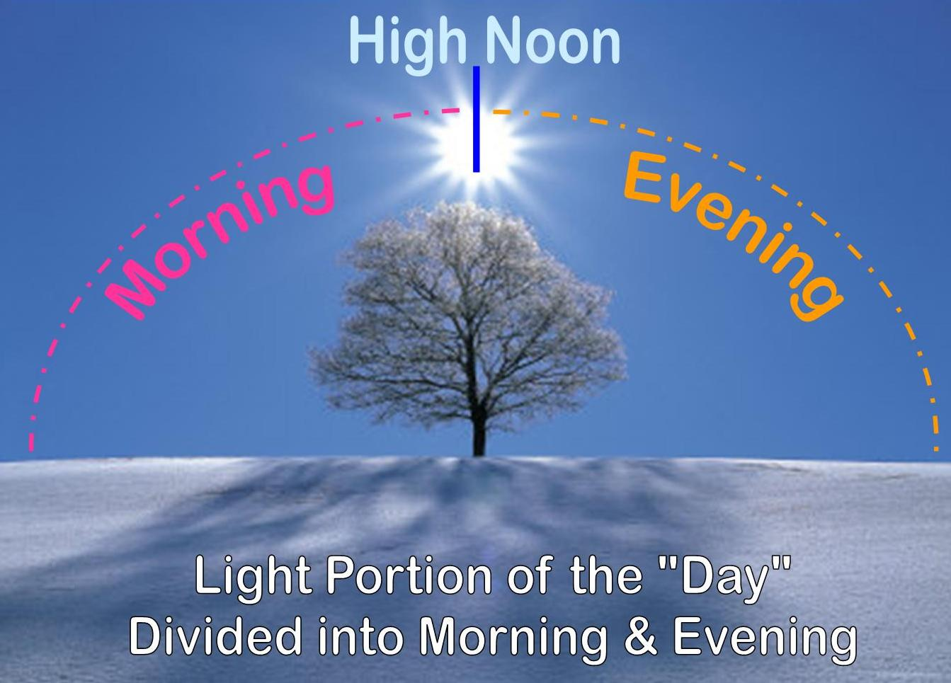
The Rabbis say:
Is this true or false?

Slide 28
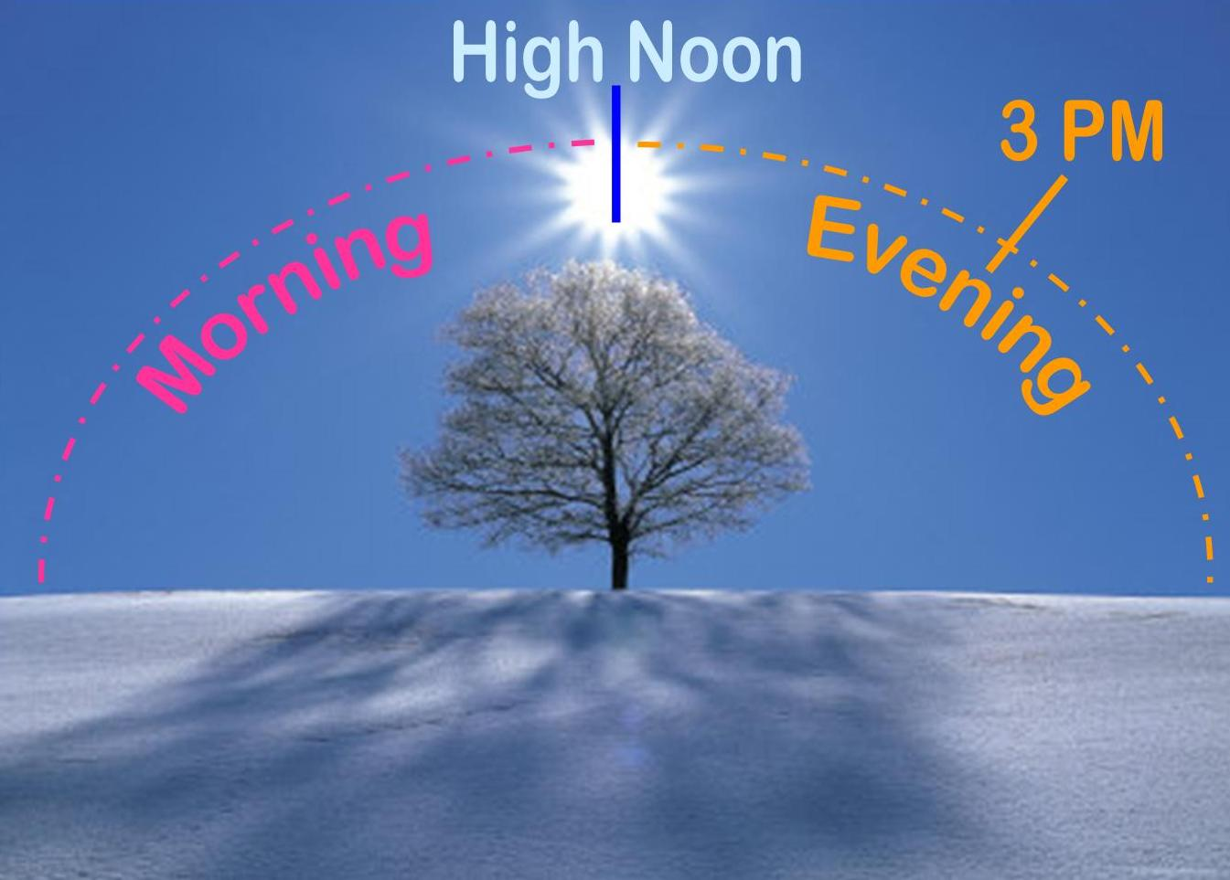
The Rabbis also say:
Although there is continual controversy [between the scholars] over when Beyn ha Arbayim actually takes place, Yahweh’s inspired Scriptures without a doubt points to the period between “noon and darkness.”
The sacrifice of the only begotten Son has given us the most documented sacrifice ever. Yahusha’s death at 3 PM on the 14th of Abib was definitely “between the evenings.”
True? False?
(See: <http://paleotimes.org/beyn-ha-arbayim/>.)

Slide 29
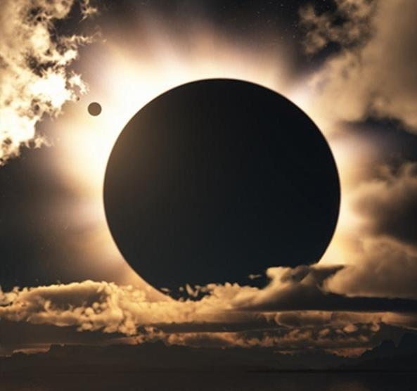
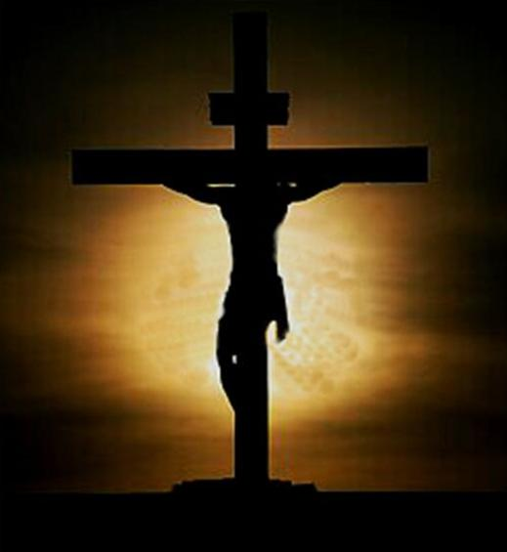

“between the evenings” at the Cross!
Light Season for Yahusha: “between the evenings” only applies to between sunrise to sunset.
(Better understood as
“between the two twilight mixings.”)
High Noon
Darkness!
(Noon qualifies for
“between the evenings”)
3 PM
(Qualifies for “between
the evenings”)
Dusk
(Does not qualify for “between the evenings”)

Slide 30
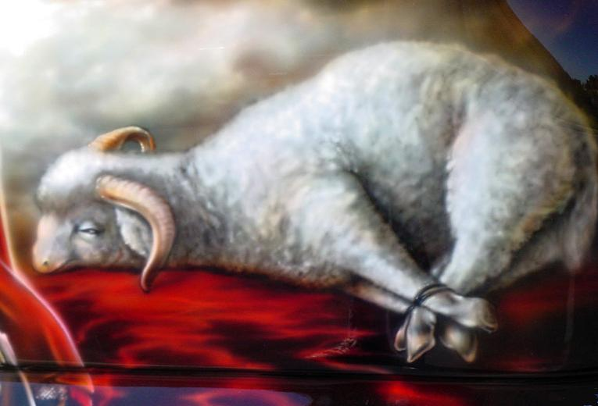
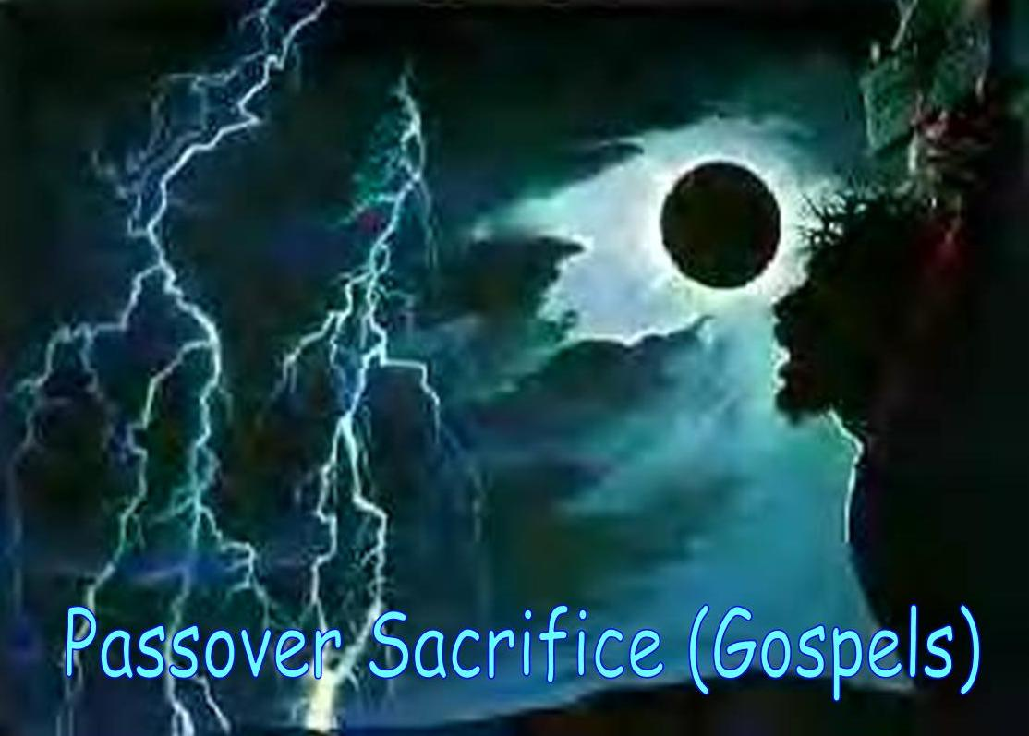
What is “type” and “antitype”?
The passover lamb of Exo 12 represents the “type” of requirements that must be fulfilled in Yahusha’s Passover.
Yahusha did satisfy these requirements as THE “antitype” or cancelling out the “type” with His Better Sacrifice.

Slide 31
What is “type” and “antitype”? [con’t]
The Exo 12 passover lamb was sacrificed “between the mixings” in the Night Season.
Yahusha laid down His life as our Passover “between the mixings” during the Light Season.

Slide 32
What is “type” and “antitype”? [con’t]
Approx. 7 PM
[Night Season]
Approx. 3 PM
[Light Season]
Note: For both Passovers, even though 3 PM is very different from the approximate 7 PM – both of them qualify for “between the mixings.”

Slide 33
“type” Fulfilled in “antitype” at 9th HR
Matt 27:45-46 Now from the sixth hour there was darkness over all the land
unto the ninth hour.
46 And about the ninth hour Yahusha cried with a loud voice, saying, Eli, Eli, lama sabachthani? that is to say, My El, my El, why hast thou forsaken me? KJV
Also see:
Mark 15:33-34; Luke 23:44-46
The 9th hour of the 14th day was exactly when our Messiah laid down His life.
This is not the same timeframe
as the Passover lamb of Egypt, but He still fulfilled the “antitype” of “between the evenings.”

Slide 34

Charting Yahusha’s Passover Sacrifice
9th Hr
6th Hr
“Between the Mixings”
One Dawn to Dawn 24 Hr Cycle
DAWN
Mixing
14th Day Season
DUSK
Mixing
14th Night Season
Question:
Does this mean
the Passover lamb of Exo 12 was
also sacrificed
at the 9th hour?
Yahusha laid down His life at the 9th hour during
the Day Season.
This qualifies for
“between the mixings”
or for “beyn ha arbayim.”
34

Slide 35
Exodus 12:8-9 (Context is still: 1st Month & 14th Cycle)
And they shall eat the flesh in that night [H3915]
(of Abib 14), roast with fire, and unleavened bread;
and with bitter herbs they shall eat it.
Eat not of it raw, nor sodden [boiled] at all with water,
but roast with fire; his head with his legs, and with
the purtenance [the bowels] thereof.
Note: The “eating command” was for “that” night – or the night that belonged to the 14th day.

Slide 36
DEFINITION FOR NIGHT:
<layil> H3915
night Strong’s; <layil> (H3915) properly,
[1] a twist (away of the light), i.e. night;
[2] figuratively, adversity:
KJV - [3] ([mid-]) [4] night (season).
night Brown-Driver-Brigg’s; <layil> (H3915)
night;
a) night (as opposed to day)
b) used of gloom, protective shadow (figurative)
Did the Exo 12 Hebrews really eat their Passover lamb at night?

Slide 37
Charting the Exo 12 Passover Events
The events of Exo 12 need special consideration.
“Between the Mixings”
One Dawn to Dawn 24 Hr Cycle
“Between the Mixings”
DAWN
Mixing
14th Day Season
DUSK
Mixing
14th Night Season
In Exo 12 the Hebrews did NOT have the option to prepare the Passover sacrifice during the Light Season of “beyn ha arbayim.” They were under the bondage of the Egyptian task masters till there was not enough light to work and such sacrifices were an abomination in the land. No sacrifices were preformed here.
The only option left was to sacrifice the Passover lamb well after sunset ON Passover day. Sunset did not change the date! Roasting can take 4+ hours.
They did EAT the lamb on the 14th NIGHT as commanded in Exo 12 in the safety of their own homes.

Slide 38

Comparing “type” & “antitype” Passovers
These 2 Passovers are special & important!
9th Hr
“Between the Mixings”
One Dawn to Dawn 24 Hr Cycle
“Between the Mixings”
DAWN
Mixing
14th Day Season
DUSK
Mixing
14th Night Season
Both Passovers of Yahusha & Exo 12 fulfill “beyn ha arbayim”
demonstrating this term can be defined as occurring on either
the Day Season [Yahusha] or the Night Season [Exo 12 lamb].
38

Slide 39
Remember:
Every detail that is
needed to understand
“beyn ha arbayim” will
be found in 3 studies
@ www.studythecalendar.com

Slide 40
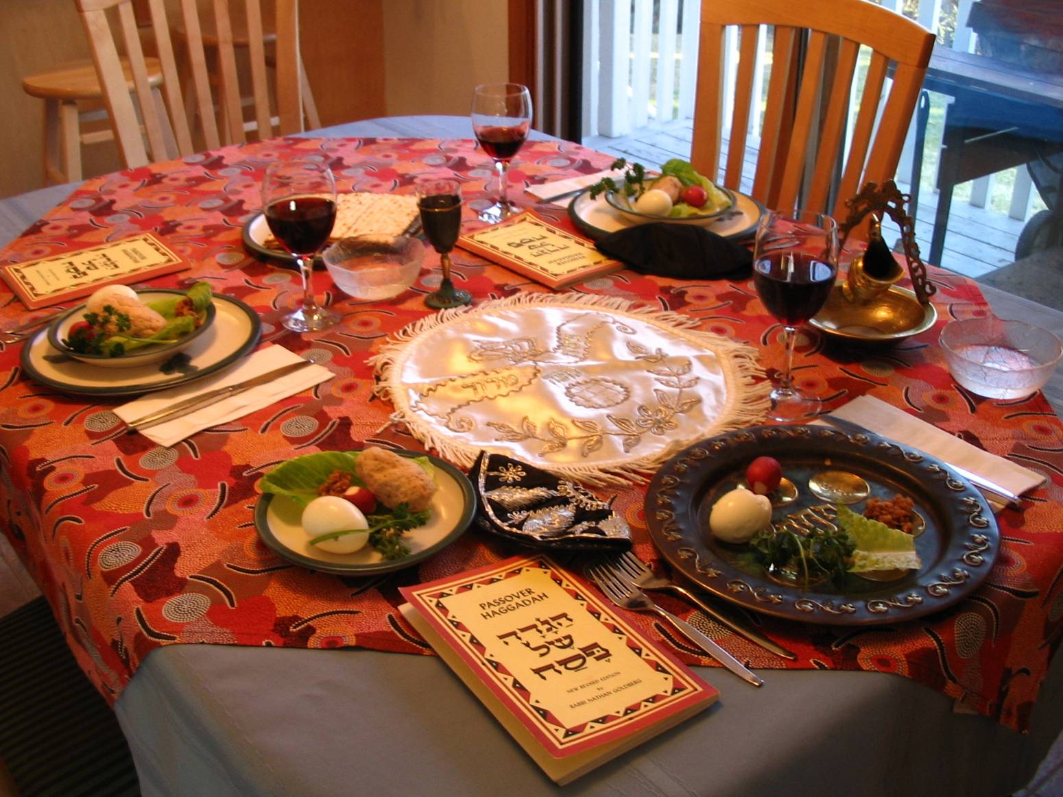
The context for Exo 12:6-9 is Passover Day, of Abib 14. Vs 8 stated the Passover meal was
to be eaten that night, [of the 14th day].
Night always follows the sunset!
(Vs 14 states this Passover Meal was an “ordinance” to be “kept forever!”)

Slide 41
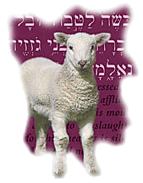
Explicit instructions were given to eat the flesh of that lamb
“in that [Passover] night” – not the next day!
Remember, as they were partaking of this Passover flesh, they were reminded
to look forward to the true Passover Lamb.
Each household could savor this thought all night long
(of Abib 14) as they handled and ate the flesh of the Passover lamb.
Soon we will see they are told no one is allowed to eat of the Passover lamb the next day!

Slide 42
Remember this thought in Exo 12:6-9:
The “eating command” was for “that” night
– or the night that belonged to the 14th day.
Question: Is it possible to obey this command if the “day/cycle” begins at sunset to usher in the Passover Festival on the 14th cycle of the month – WHEN – the Rabbis believe the sacrifice was at
the 9th hour on the Day Season of the 14th?
It doesn’t matter if you say Abib 14 starts with “sunset” or “dawn”- we do know this for sure … Abib 14 will have a Day Season and a Night Season.
It’s time to check some charts for exo 12 according
to the rabbis & the common mindset of today!

Slide 43


Rabbis Exo 12: Sunset Theory Chart #1
Dusk Dawn Sunrise Noon
Keeping the events ON the SAME day of Abib 14.
Sunset
Sunset
The sun goes down between noon & sunset.
One Sunset to Sunset 24 Hr Cycle
9th Hr
DUSK
Mixing
14th Night Season
DAWN
Mixing
14th Day Season
There is NO Forward Progressive Movement of these events!
1) The Lamb is to be eaten after sunset
during the Night Season
of Abib 14.
2) Any left-over portions are burned that night, before the light of the Day Season arrives.
3) THEN after the Night Season is over, the Passover lamb is slain 9 hours later at the 9th hour of the 14th Day Season??
5) By the way – this
is IMPOSSIBLE!
4) Why? The Rabbis say the Passover lamb is to be sacrificed at the 9th Hr of Passover Day Season between noon & sunset – or between the evenings.
Sunset
Twist #1:
Abib 14 begins with sunset!
How will this affect the order of events?

Slide 44

Rabbis Exo 12: Sunset Theory Chart #2
Sunrise Noon
Keeping the events IN order ON the TWO different days.
Sunset
Sunset
The sun goes down between noon & sunset.
One Sunset to Sunset 24 Hr Cycle
9th Hr
DUSK
Mixing
14th Night Season
DAWN
Mixing
14th Day Season
15th ULB
1) Why? The Rabbis say the Passover lamb is to be sacrificed at the 9th hour
on the Passover Day Season between noon & sunset.
Sunset Twist #2:
Abib 14 at the 9th hour is indeed the
sacrificial time for the Passover lamb.
Moving forward, Sunset arrives, and
changes the cycle from Abib 14 to Abib 15.
Question: How does one eat the Passover lamb, on Passover 14th,
when the cycle changed to Abib 15th – the Feast of Unl. Bread?
Have the Divine requirements been obeyed even
though there is a Forward Progressive Movement?
2) The Lamb is eaten after sunset
during the Night Season
of Abib 15.

Slide 45
The Exo 12 Passover events cannot be charted properly in a “Forward Progressive Movement” according to the Rabbis’ and current mindset of a sunset day-start.
Neither will sunset commencement properly
align the events for Yahusha’s Passover.
We do know the Exo 12 Passover lamb was sacrificed AND eaten at night. So … no matter what the day-start is, there would not be a problem here – UNTIL the departure command to leave the next morning which would be Abib 14th, not the 15th of Num 33:3.
However, it’s time to chart Yahusha’s Passover
in a Dawn Format Chart and see if the events follow
the Forward Progressive Movement.

Slide 46

Yahusha’s Passover: DAWN Format Chart#1
Dawn Sunrise Noon Sunset Dusk
There’s only one more option to try – starting the Passover of Abib 14th with DAWN.
Keeping the events IN perfect order ON Abib 14.
9th Hr
“Between the Mixings”
“Between the Mixings”
One Dawn to Dawn 24 Hr Cycle
DAWN
Mixing
14th Day Season
Dusk
Mixing
14th Night Season
1) Yahusha died “between the mixings.”
2) Yahusha’s Body handled “between the mixings.”
There is
PERFECT
Forward Progressive Movement
of these events!
Dawn’s Delight #1:
The 9th hour sacrifice is on Abib 14.
Sunset arrival on Abib 14 ushers in the dusk.
Our Passover Lamb was handled all night of Abib 14 in burial.
Just before DAWN arrived the stone was rolled to close the tomb.
All “antitype” requirements were fulfilled. Abib 15 Sabbath begins at Dawn.
46

Slide 47
What about the
rest of the
requirements?

Slide 48
Exodus 12:10 (Context is still: 1st Month & 14th Cycle)
And ye shall let nothing of it remain until the morning; [H1242] and that which remaineth of it until the morning ye shall burn with fire.
morning Strong’s H1242; boqer; from H1239;
properly, dawn (as the break of day); generally, morning:
KJV - (+)day, early, morning, morrow.
H1239; baqar; a primitive root; to plough, or (generally) break forth.

Slide 49
DEFINITION FOR MORNING:
<boqer> H1242
morning Brown-Driver-Brigg’s; <boqer> (H1242)
morning, the break of day
a) morning
1) used of end of night
2) used of coming of daylight
3) used of coming of sunrise
4) used of beginning of day
5) used of bright joy after a night of distress (figurative)
b) the morrow, the next day, the next morning

Slide 50
Other Translations for Exodus 12:10
Exo 12:10 Do not leave any of it until the next day. Whatever is not eaten that night must be burned before morning. NLT
Exo 12:10-11 You must not leave any of it until morning; if any is left over, it must be burned. TEV
Exo 12:10 Don't eat any of it the next day; if all is not eaten that night, burn what is left. TLB
In other words:
“All leftovers of the Passover lamb
must be disposed before the morning.”
Why? There are several reasons.

Slide 51
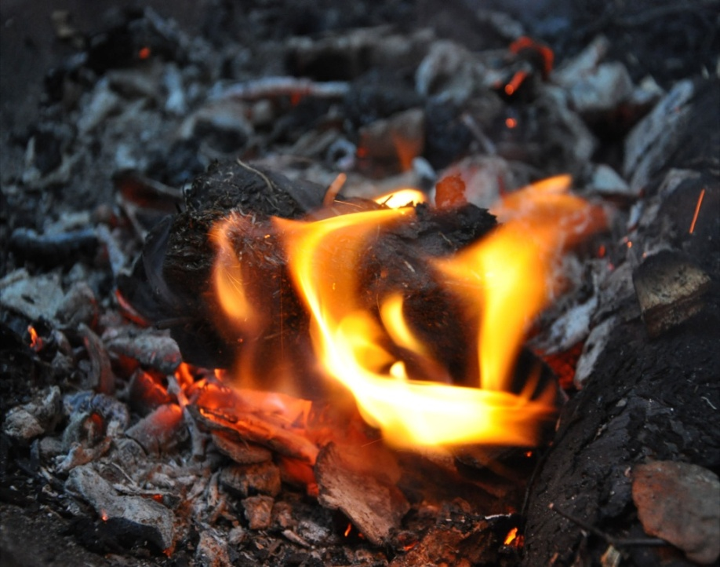
The Morning Ushers in Abib 15
Exodus 12:10
And ye shall let nothing of it remain until the morning; and that which remaineth of it until the morning ye shall burn with fire.
The Passover lamb of Exo 12 is a “type” for the “Antitype.” It must be burned (or out of sight) before the morning transitioned to Abib 15. Gospel Passover Application: So it is with our Messiah and His lifeless Body. HE must be “in the tomb; out of sight” on Passover night, before the morning of Abib 15. (We’ll discuss this in detail with the Gospel account of our Messiah’s death, burial and resurrection.)
Notes:
I’m giving you a teacher’s nugget here – for those that would appreciate such. As I go through studies, I am thrilled when I find nuggets, especially ones that connect events to the Passion of our Messiah and His cross. We will save the full explanation of this nugget for the study on DAWN through the gospel account. However, I wanted you to know that the gospel account is going to connect with Exodus 12, which in turn has a strong link to Genesis 15.
I mentioned this last week with the Gen 15 study – how the events connected to Ex 12, but I think it may have caused some confusion. So, just store this information on the back burner for now, or use it to further your own studies.

Slide 52
Conflict Between Verses 10 & 22?
Verse 10 gives explicit instructions that if any
portion of the lamb could remain until the
morning, it has to be burned with fire.
For obvious reasons, this disposal would not be done inside their dwelling place.
In verse 22, instructions are given for the people to remain
in their homes till morning.
How would this be accomplished if lamb leftovers must be burned before morning?
There is no problem! We understand the homes of the people during the Exodus 12 timeframe were constructed to take care
of housing the family and animals in a safe place.
The courtyard portion of the dwelling place provided a place to burn the leftover lamb, without being outside the dwelling place.
Notes:
We’ve just looked at verse 10 very seriously. I would like to compare that to verse 22 right here to see if we have a conflict between these two verses.

Slide 53

What Happens in the Morning?
Abib 14
Ends
At
Dawn
<boqer>
Abib 15
Begins
With
Daybreak
<boqer>
Notes:
Both verses 10 and 22 have something to do with the morning. What happens in the morning? I hope by now you can see that Abib 14 will be ending with the dawn of morning, and Abib 15 begins at the next moment with daybreak. It’s a Divine transition point from one cycle to the next.

Slide 54
Exodus 12:11-13 (Context is still: 1st Month & 14th Cycle)
And thus shall ye eat it; with your loins girded, your shoes on your feet, and your staff in your hand; and ye shall eat it in haste: it is Yahuah’s passover [meal].
For I will pass through the land of Egypt this night, [Passover Deliverance on the night of the 14th cycle] and will smite all the first born in the land of Egypt, both man and beast …
And the blood shall be to you for a token upon the houses where ye are: and when I see the blood, I will pass over you, and the plague shall not be upon you to destroy you, when I smite the land of Egypt.
And this day shall be unto you for a memorial; and ye shall keep it a feast to Yahuah throughout your generations; ye shall keep it a feast
by an ordinance for ever.
Notes:
The context of these verses is still the 14th cycle – the Passover Feast cycle – specifically the Night Season.

Slide 55
Exodus 12:18, 22, 29 (Another Review: 14th Cycle)
In the first month, on the fourteenth day of the month at even [dusk], ye shall eat unleavened bread…
… and none of you shall go out at the door of his house until the morning [break of day on Abib 15 {Num 33:3}].
And it came to pass, that at midnight [Abib 14] Yahuah smote all the firstborn in the land of Egypt …
Num 33:3 specifically says Israel departed Egypt on the
15th day, the morrow after the Passover. Now, a question:
With a sunset day-start, the Day Season follows the Night meaning Abib 14th “day” follows Abib 14 “night.” How can Israel follow the command to leave on the morning of the 15th once the lamb is burned, if there is an interruption of an Abib 14 Day Season?
Notes:
I’d just like to put these verses together that mention the events falling on the Passover Night Season of Abib 14. Another review should be good, right?

Slide 56
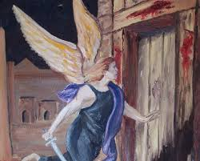
Exo 12 Passover: DAWN Format Chart#2
Dawn Sunrise Noon Sunset Dusk
There’s only one more option to try – starting the Passover of Abib 14th with DAWN.
Keeping the events IN order ON Abib 14.
One Dawn to Dawn 24 Hr Cycle
Mid-Night
“Between the Mixings”
DAWN
Mixing
14th Day Season
Dusk
Mixing
14th Night Season
There is PERFECT Forward Progressive Movement
of these events!
1) Eat the lamb on “this night” of 14th.
2) “When
I see the blood, I will pass over you at midnight.”
3) Left-overs burned before Abib 15.
Dawn’s Delight #2:
The Passover meal can last all night on Abib 14.
Death Angel “passed over” with a Midnight
Deliverance from Egyptian bondage on Abib 14.
Left-over lamb must be burned before morning of the 15th.
No one leaves the house until the morning of the 15th.
All Divine requirements have been obeyed;
All Passover events occur on the 14th. Abib 15 begins at Dawn.
56

Slide 57
Exodus 12 is the Foundation
Exodus 12 is the first place in Torah where the phrase “beyn ha arbayim” is found referring to only the Night Season. [In other testimonies “beyn ha arbayim”
does refer to the Day Season.]
Due to the circumstances, Egypt’s Passover lamb was not eaten until well into the night of Abib 14 (that followed the Day Season of the 14th). Therefore it would have been impossible for Yahuah’s people to obey the command to eat the Passover lamb on Abib 14th if sunset changed the date to the 15th.
Because of this, the Sunset Theory automatically disqualifies itself.
There is no command anywhere in Scripture to eat the Passover lamb
at the “sunset/dusk” portion where it declares Abib 15th begins and
ushers in the first Sabbath Feast of Unleavened Bread.
If this is so, the Passover meal will never be eaten
on Passover Day connected to the date of Abib 14!
Next: Will King Josiah’s massive Passover celebrations align with
Exodus 12s Dawn Day commencement or with Sunset Theory?
Notes:
Give experience of our 1st Passover at Bella Coola – and Gordon’s comment about the Passover meal being eaten on the beginning of the 1st Sabbath of ULB because the sun had just set.

Slide 58
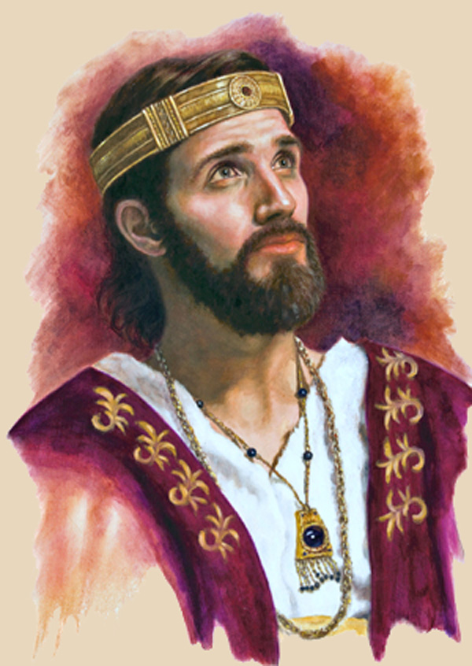
3rd Witness: 2 Chronicles 35
King Josiah’s Passover
In about 624 BC, this
was a Massive Passover
of 41,400 sacrifices!
[~ 875+ Years after Exodus 12]
2 Chron 35:18 And there was no passover like to that kept in Israel from the days of Samuel the prophet; neither did all the kings of Israel keep such a passover as Josiah kept … KJV
This testimony mentions both the Day Season and the Night Season.
Questions: Were all of these Passover sacrifices eaten
on Abib 14th or not? Was Josiah obedient to the Torah?
Notes:
Our 3rd Witness from 1 Chron 35 is an interesting one. Let’s take a look at a few of the verses. This account happened approx 624 BC – or close to 900 years after Exodus 12. Do you think they are celebrating Passover according to the Divine instructions that Moses received?

Slide 59
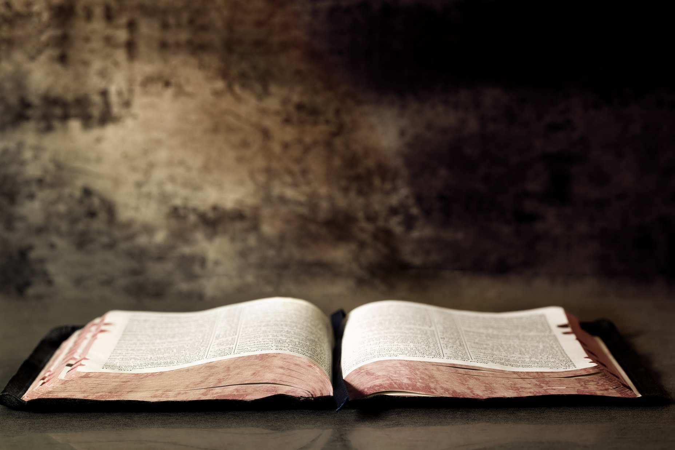
3rd Witness: 2 Chronicles 35:1, 7-9
Moreover Josiah kept a passover unto Yahuah in Jerusalem:
and they killed the passover on the fourteenth day of the first month.
And Josiah gave to the people, of the flock, lambs and kids, all for the passover offerings, for all that were present, to the number of thirty thousand, and three thousand bullocks:
these were of the king's substance [33,000].
And his princes gave willingly unto the people … passover offerings two thousand and six hundred small cattle, and
three hundred oxen [2900].
… gave unto the Levites for passover offerings five thousand small cattle, and five hundred oxen [5500] [a total of 41,400 sacrifices].
Notes:
In this Passover Account, we will read several verses from 2 Chron 35 about this spectacular event. The math may surprise you!

Slide 60
2 Chronicles 35:11, 12, 13
11 And they killed the passover, and the priests sprinkled the blood from their hands, and the Levites flayed them.
12 And they removed the burnt offerings, that they might give according to the divisions of the families of the people, to offer unto Yahuah, as it is written in the book of Moses. And so did they with the oxen.
13 And they roasted the passover with fire according to
the ordinance: but the other holy offerings … they … divided them speedily among all the people …
Remember: This is a total of 41,400 Passover Sacrifices on ONE Passover Celebration!

Slide 61
2 Chronicles 35:14, 16
14 And afterward they made ready for themselves, and for the priests: because the priests the sons of Aaron were busied in offering of [41,400] burnt offerings and the fat until night [<layil> H3915]; therefore the Levites prepared for themselves, and for the priests the sons of Aaron.
16 So all the service of Yahuah was prepared
the same day, to keep the passover, and to offer burnt offerings upon the altar of Yahuah, according to the commandment of king Josiah.

Slide 62
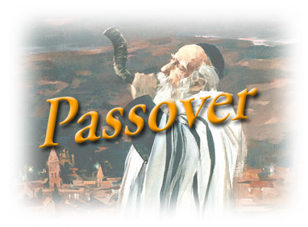
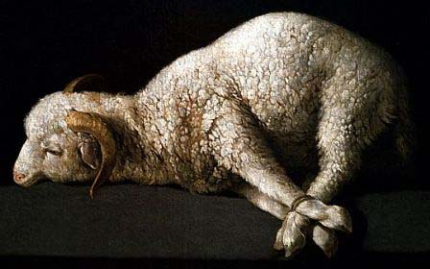
Another witness in 2 Chronicles agrees with Exodus 12 that “all the service of Yahuah was prepared the same day” for 41,400 sacrifices.
In other words they killed, cooked and ate the lamb during the 24 hours of the 14th day (cycle). These tasks took place during the hours of the Light Season AND up until the following Night Season.
That means: the time after sundown was still the 14th day. And as we read earlier in Exodus 12:10, whatever
remained of the Passover lamb
on the last hours of the 14th cycle
(of Passover), had to be burned
before the dawning of the new
cycle [15th] according to Moses.

Slide 63
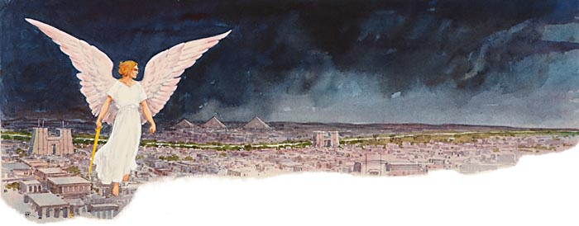
Remember – approximately 900 years before Josiah’s Passover, the death angel passed over that same night. He Passed OVER on PASSOVER DAY – at midnight(!) which was still on the hours of the 14th cycle and not the beginning of the 15th, or the next cycle.
In celebration of this wonderful deliverance, King Josiah celebrated everything according to the words of Moses.
Notes:
Ending comment: We will now examine the Ex 12 charts – considering the Sunset Theory, and the Dawn Day … for all of the Passover requirements. As we look at the charts, consider Josiah’s experience as well. If Josiah observed a Sunset Day, he would have had the same problems as we find on the Sunset Chart.

Slide 64
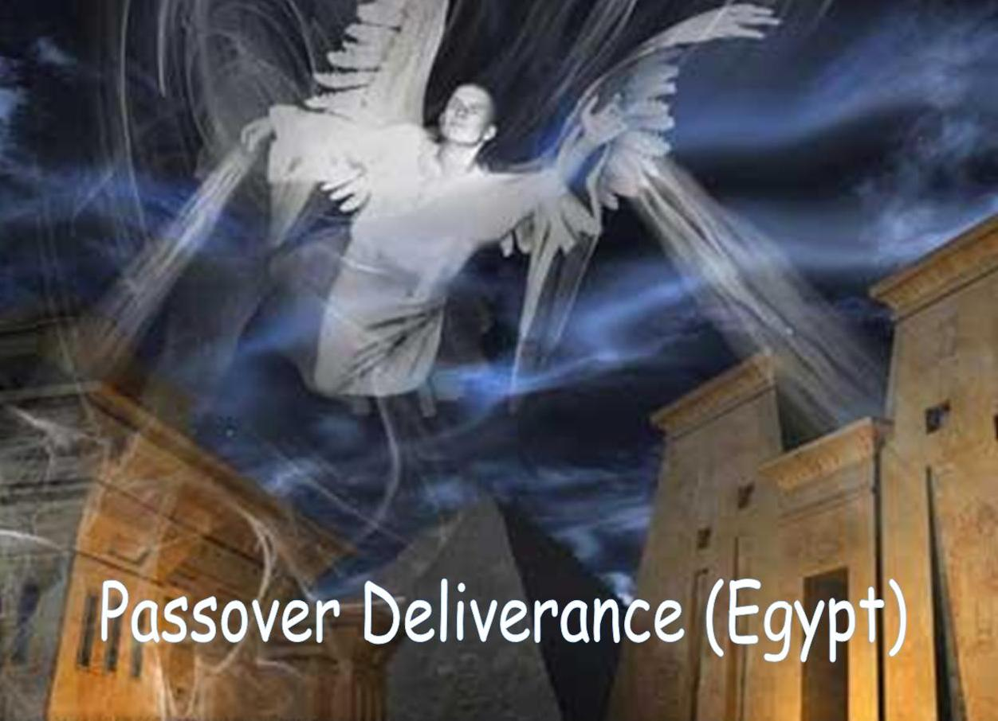
Exo 12: Passover Day Festival Schedule
Daylight Season (Abib 14 – for those not in the fields of bondage)
1) Unleaven the premises
Prepare unleavened bread and other items for Passover meal
Sunset Moment (Still Abib 14)
Around Dusk Twilight (Still Abib 14 – after release from bondage)
Sacrifice Passover lamb “between the evenings” [Night Season]
Bleed, skin & roast Passover lamb [several hours are needed]
Night Season (Still Abib 14)
Prepare to eat Passover lamb throughout the night
Midnight Moment (STILL Abib 14)
Passover Deliverance from Death Angel
Dispose of left-over lamb by fire before
morning (where the 14th transitions to the 15th)
Do not leave the house till morning
Notes:
The “houses” in that kind of living environment all have a fire facility outside/directly adjacent too, the house proper for cooking and heating. It is my understanding that it was the “courtyard” of the house that was the safe haven. The remains of the lamb would not be burned inside of the house. The smell alone would drive them outside!

Slide 65

So, When Is Passover?
Hey, everyone … Passover is on
April 3rd this year.
Meet you there!
Note: A random date for Passover was chosen.
That means we should start unleavening our homes in
the morning of April 3rd!
And, we’ll meet to
celebrate the Passover meal at dusk on April 3rd! See you there!
When the day begins at DAWN there is no confusion about the commencement date & time for Passover.

Slide 66

Exodus 12:40, 41, 51
Comparison of the 430/400 Year
Timeline Between Abram (Gen 15)
and the Exodus (Exo 12)
Timelines are important for Yahuah’s people to understand just “where
they are in the stream of time.”
Like the sand in an hourglass,
the 400/430 year timeline gave
an indication as to when Yahuah’s people would be free of
the Egyptian bondage.

Slide 67
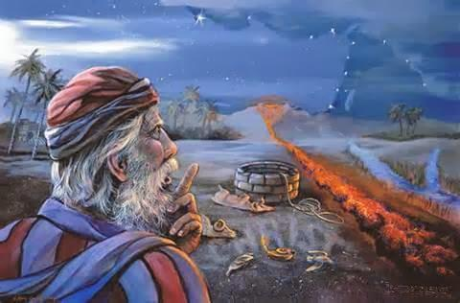
Gen 15 & Acts 7 Speak of 400 Years
Promise Given: In Gen 15:13 Abram was told his seed would be in bondage in a strange land for 400 years.
And he said unto Abram, Know of a surety that thy seed shall be a stranger in a land that is not theirs, and shall serve them and they shall afflict them four hundred years.
This Divine promise was sealed [vs 17] as Abram’s sacrifices were consumed by the smoking furnace and burning lamp when it was dark.
Acts 7:6 And Yahuah spake on this wise, That his seed should sojourn in a strange land; and that they should bring them into bondage, and entreat them evil four hundred years.

Slide 68
Exo 12 & Gal 3 Speak of 430 Years
Exo 12 has the rest of the story. However, it uses the 430 year timeline, rather than 400 years.
Ex 12:40 Now the sojourning of the children of Israel, who dwelt in Egypt, was four hundred and thirty years.
Gal 3:16-17 Now to Abraham and his seed were the promises made … And this I say, that the covenant, that was confirmed … which was four hundred and thirty years after, cannot disannul, that it should make the promise of
none effect.
Timelines Are Exact!

Slide 69
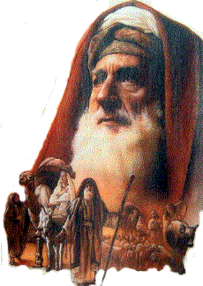
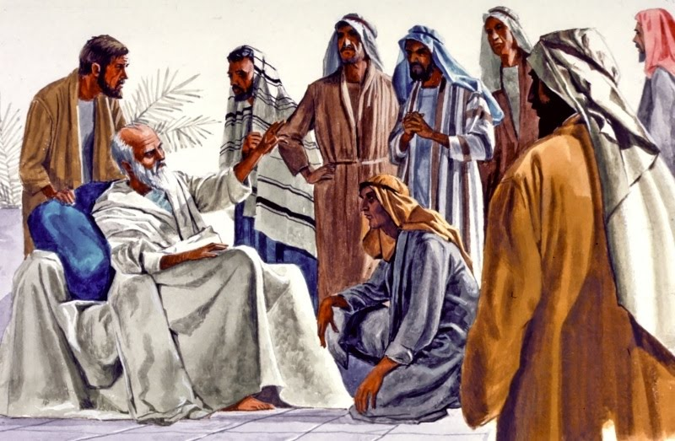
Harmonizing the Two Timelines of
400 Years and/or 430 Years
Gen 15:13 and Acts 7:6
speak of 400 years.
Ex 12:40 and Gal 3:16-17
speak of 430 years.
The period of 400 years, and
430 years can be harmonized
by acknowledging the different starting dates.
The 430 years begins with Abram’s call to leave Haran.
The 400 years begins 30 years later when Ishmael started to afflict [or taunt] Isaac.
Two 215 Year Timelines:
#1 Abram leaves
Haran at age 75 …
to Jacob’s entry into
Egypt = 215 years.
#2 Jacob’s entry into Egypt … to the exodus = 215 years.

Slide 70
The “GEM” of Gen 15 & Exo 12
Gen 15:18 In the same day [when it was dark], Yahuah made a covenant with Abram, saying, Unto thy seed have I given this land …
Exo 12:40 has the rest of the story. Now the sojourning of the children of Israel, who dwelt in Egypt, was four hundred and thirty years.
Exo 12:41 And it came to pass at the end of the four hundred and thirty years, even the SELF SAME DAY it came to pass, that all the hosts of Yahuah went out from the land of EGYPT.
Notes:
Timelines are exact … this needs to go in somehow.

Slide 71
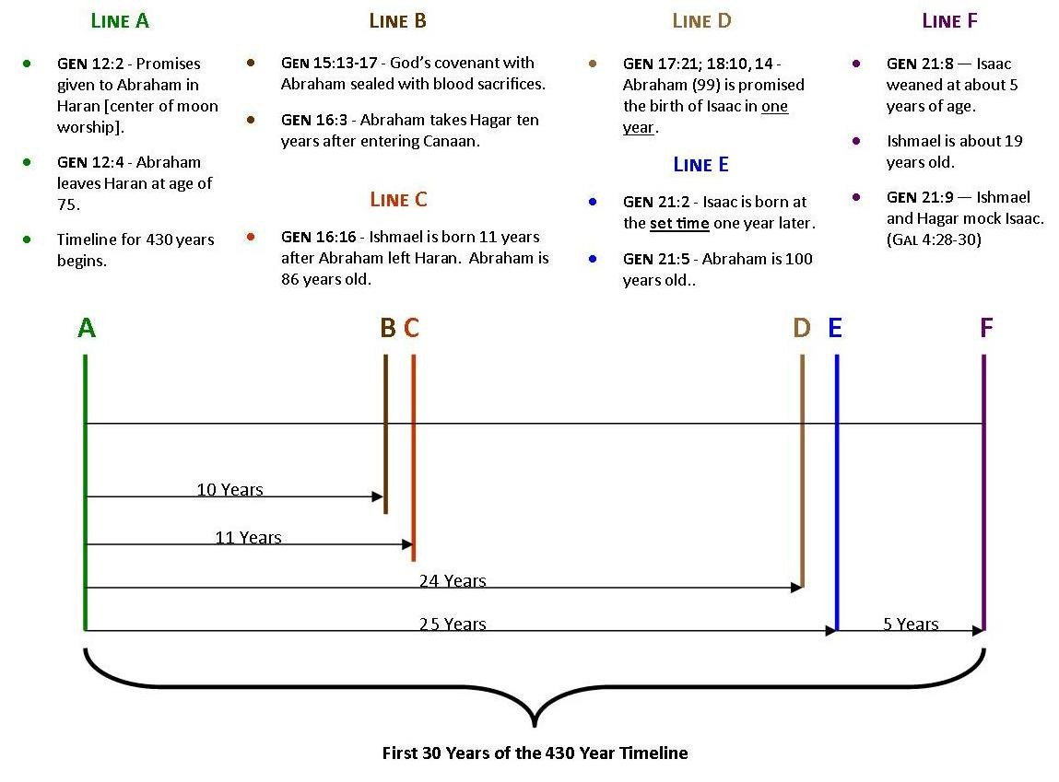
The First 30 Years of the 430 Years
Notes:
Timelines are exact … which makes them so much fun to study. (Charts taken from pgs 70-71 in my Daniel book.)
On this timeline chart I would like you to notice that all the scriptures given are in order from Gen chapter 12 to Gen 21.
Many things happened in the first 30 years of the 430 year timeline.

Slide 72
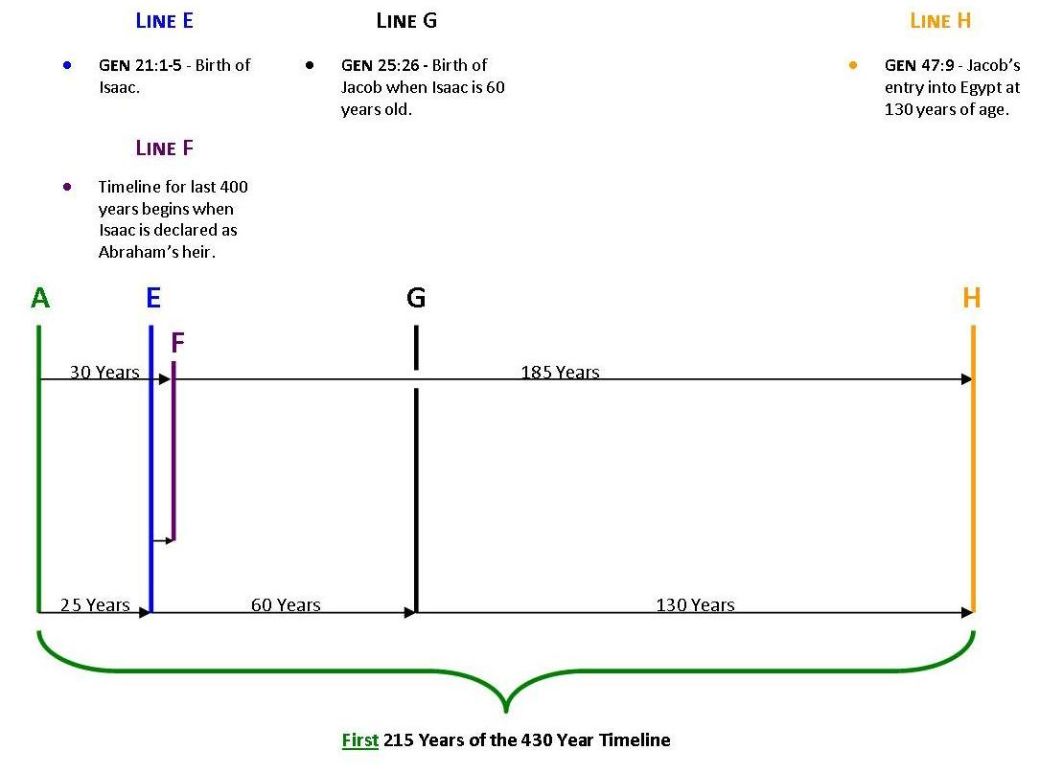
The First 215 Years of the 430 Years
Notes:
This timeline records the order of events from Gen 21 to Gen 25 and Gen 47.
The first 30 years (from the previous chart) is recorded here between the green line to the blue line.

Slide 73
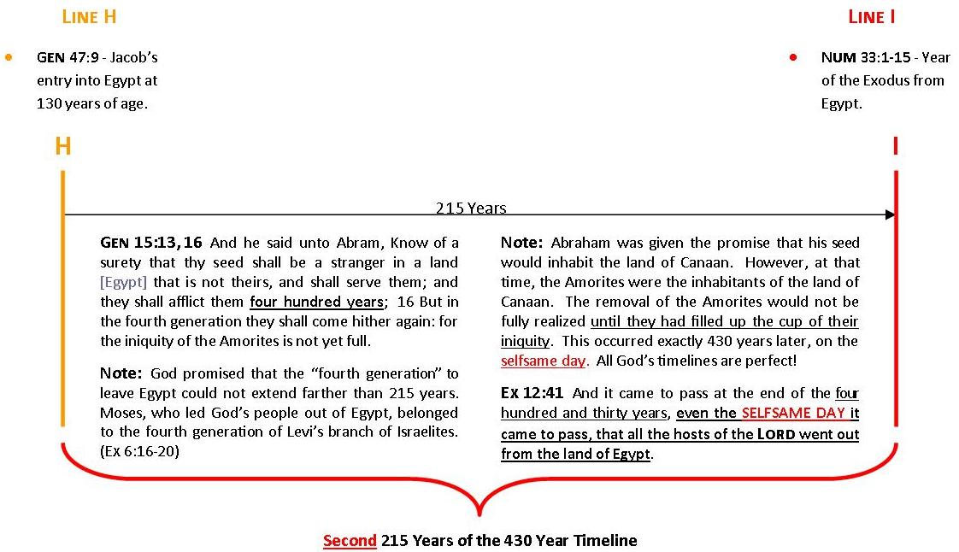
The Second 215 Years of the 430 Years
Ex 12:29 And it came to pass, that at midnight [Abib 14]
Yahuah smote all the firstborn in the land of Egypt …
Promise Honored: Moses, who led Yahuah’s people out of Egypt, was the fourth generation of Levi. (Ex 6:16-20)
Once that timeline was completed, his seed was delivered
from bondage on the SELF SAME DAY – Passover / Abib 14.
What day was the promise made to Abraham 400/430 years before? Passover?
Notes:
This timeline picks up the events from Gen 47 to the time of departure from Egypt as given in Num 33:1-15.

Slide 74
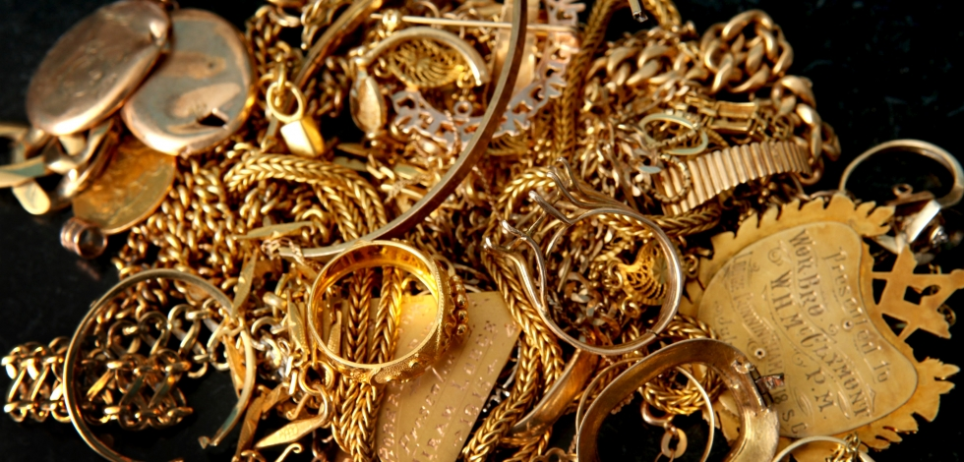
Exodus 12:35-36
Spoiling the Egyptians!
When did it happen?
Ex 12:35 And the children of Israel … borrowed of the Egyptians jewels of silver, and jewels of gold, and raiment.

Slide 75
When Did the Israelites Spoil the Egyptians?
The Passover meal was not eaten until the Night Season.
All were commanded to stay within their dwellings [vs 22] “and none of you shall go out of the door of his house until morning.” BUT …
Vs 10: The left-over lamb had to be burned before morning which would not be done inside a closed structure.
However: We now understand that the courtyard of
their dwelling places were considered part of their home.
To burn the left over lamb in the courtyard, was not a violation of the Divine command.
So, there was no disobedience!
Then, verses 34-35 tell us about the Egyptians being spoiled by the Israelites after the verses of the midnight plague.
It sounds like the Israelites left their dwelling places after all. Did they, or did they not?

Slide 76
Ex 12:31-33 (Context is still: 1st Month & 14th Cycle after Midnight)
31 And he [Pharaoh] called for Moses and Aaron by night, and said, Rise up, and get you forth from among my people, both ye and the children of Israel; and go, serve Yahuah, as ye have said.
32 Also take your flocks and your herds, as ye have said, and be gone; and bless me also.
33 And the Egyptians were urgent upon the people, that they might send them out of the land in haste; for they said, We be all dead men.
Does it sound like Moses and Aaron left their dwelling place?
Notes:
Does it sound like Moses and Aaron left their dwelling place? Not likely. Everyone was commanded to stay within their dwelling place. Could it be that Pharaoh sent a servant, or a soldier to seek out Moses and Aaron to deliver his message to “get out and go serve your God.” Is that possible? Do you think the Scriptures would have recorded any acts of disobedience in this case?

Slide 77
Ex 12:34-36 (Context is still: 1st Month & 14th Cycle after Midnight)
34 And the people took their dough before it was leavened,
their kneadingtroughs being bound up in their clothes upon
their shoulders.
35 And the children of Israel did according to the word of Moses; and they borrowed of the Egyptians jewels of silver, and jewels of gold, and raiment:
36 And Yahuah gave the people favour in the sight of the Egyptians, so that they lent unto them such things as they required. And they spoiled the Egyptians. KJV
Does it sound like they left their houses?

Slide 78
We Must Pay Attention To Grammar
In verses 35 and 36 we find phrases such as this:
… the children of Israel did …
… they borrowed …
… they [Egyptians] lent …
… they [Israelites] spoiled the EGYPTIANS.
Comment: It really does sound like the Israelites left their dwelling places to gather in all their precious items.
Question: Would they disobey a Divine command?
Notes:
Next, let’s look to Exodus 3 to recall the Divine promise.

Slide 79
Comparison to Exodus 3:21-22
In Exodus 3 Yahuah gave a promise.
The Israelites would not leave Egypt empty-handed.
21 And I will give this people favour in the sight
of the Egyptians: and it shall come to pass, that, when ye go, ye shall not go empty:
22 But every woman shall borrow of her neighbour, and of her that sojourneth in her house, jewels of silver, and jewels of gold, and raiment: and ye shall put them upon your sons, and upon your daughters; and ye shall spoil the Egyptians.
Notes:
Next we will make another comparison to Exodus 11.

Slide 80
Exodus 11 follows the 9th plague of darkness. Exodus 12 sets the timeframe as the 1st month. Therefore, we will find the Israelites spoiled the Egyptians after the 9th plague, around the time of the beginning of the 1st month. This task was completed early!
Comparison to Exodus 11:1-5
1 And Yahuah said unto Moses, Yet will I bring one plague more upon Pharaoh, and upon Egypt; afterwards he will let you go hence: when he shall let you go,
he shall surely thrust you out hence altogether.
2 Speak now in the ears of the people, and let every man borrow of his neighbour, and every woman of her neighbour, jewels of silver, and jewels of gold.
3 And Yahuah gave the people favour in the sight of the EGYPTIANS. Moreover the man Moses was very great in the land of Egypt, in the sight of Pharaoh's servants, and in the sight of the people.
4 And Moses said, Thus saith Yahuah, About midnight will I go out into the midst of Egypt:
5 And all the firstborn in the land of EGYPT shall die, from the firstborn of Pharaoh that sitteth upon his throne, even unto the firstborn of the maidservant that is behind the mill; and all the firstborn of beasts.

Slide 81
Putting It All Together
The grammar in the KJV is correct if we pay attention to it very carefully. However the context of verses 35-36 does read better in the NKJV.
Exo 12:35 Now the children of Israel had done according to the
word of Moses, and they had asked [in 11:2] from the Egyptians articles of silver, articles of gold, and clothing.
36 And Yahuah had given [in 11:3] the people favor in the sight of
the Egyptians, so that they granted them what they requested. Thus they plundered the Egyptians. NKJV
Conclusion: Here Moses simply records the Israelites had plundered the Egyptians (just as they were commanded to) after the 9th plague. Therefore, none needed to leave the courtyard of their homes during the Night Season of Passover for any reason. They were obedient to the commands given in Exodus 11 and Exodus 12.
Notes:
Now that we know the Israelites did NOT leave their houses “all that night” – the big question is …

Slide 82
When Did The Israelites Leave?
The command was, “Don’t leave your house until morning.” They were to stay “put” the whole Night Season of Abib 14. Then:
Exo 12:37 And the children of Israel journeyed from Rameses to Succoth …
Num 33:3 And they departed from Rameses in the first month, on the fifteenth day of the first month;
on the morrow after the passover the children of Israel went out with an high hand in the sight of all
the Egyptians. KJV
Conclusion: All the events for Exodus 12 are in orderly alignment - a perfect Forward Progressive Movement.

Slide 83
There’s only one more option to try – starting the Passover of Abib 14th with DAWN.
When Did the Israelites Leave Egypt?
Dawn Sunrise Noon Sunset/Dusk Dawn
Midnight Deliverance
One Dawn to Dawn 24 Hr Cycle
“Between the Mixings”
DAWN
Mixing
14th Day Season
Dusk
Mixing
14th Night Season
15th ULB
1) Passover Slain; Blood on Doorposts; Passover Eaten
Dawn’s Delight ~
out of Egypt:
Sunset arrival on Abib 14 ushers in the dusk.
The Passover sacrifice is on Abib 14 after sunset; eaten at night.
The Passover lamb was handled all night of Abib 14 in memorial.
Death Angel “passes over” homes with blood at midnight; bondage removed.
Any uneaten lamb must be burned before dawn of the 15th.
Abib 15 Unleavened Bread Sabbath at Dawn & Departure from Rameses.
2) Do not go out of the house till morning.
Departure from Rameses the morrow after the Passover, on the 15th day of ULB Sabbath.
83

Slide 84
Question Time For Exodus 12
Some feel the Passover Feast Day begins at sunset on Abib 13. They prepare to eat the Passover Meal at dusk (after sunset), believing this is now Abib 14.
However, there’s another problem! The children of Israel were commanded to leave the morrow after which would be
the Day Season of Abib 14.
Num 33:3 confirms they left on the morning of Abib 15th – not the morning of Abib 14th.
Something to Ponder:
The sunset commencement causes conflict between Exo 12 and Num 33.
Only the Dawn Day-start
- as found in Gen 1 -
has the solution.
The End
Notes:
All through the presentation we’ve posed some similar questions. Maybe this is the last time these questions will ever have to be asked.
Some feel the Passover Feast Day begins at sunset on Abib 13. They prepare to eat the Passover Meal at dusk (after sunset), considering this is now Abib 14.
But, Abib 13 is not commanded as the Preparation Day for unleavening the home and sacrificing the Passover Lamb!
However, there’s another problem: according to Sunset Theory, the sunset on Abib 14 ushers in Abib 15, as the 1st Feast Sabbath of Unleavened Bread.
So … Is the Passover Meal to be eaten on the early hours of the Sabbath of Unleavened Bread, Abib 15? Does that make sense?
This brings us to another question: Would the Passover deliverance at midnight really have been on Abib 15 – or ULB Sabbath?
Wouldn’t it make more sense to have the Passover Deliverance on the cycle of the Passover Feast day?
Do you have any other questions?

Slide 85

May every Passover provide
a special blessing through
Covenant Calendar simplicity.
Send your questions & comments to:
questions@studythecalendar.com

Slide 86
USED TO BE SLIDE 44 – I DON’T THINK WE NEED IT ANYMORE. SLIDE 43 IS ADEQUATE.
Exodus 12: Sunset Theory Chart #1b
Dusk Dawn Sunrise Noon
Keeping the events ON the SAME day of Abib 14.
Sunset
Sunset
The sun goes down between noon & sunset.
One Sunset to Sunset 24 Hr Cycle
9th Hr
DUSK
Mixing
14th Night Season
DAWN
Mixing
14th Day Season
IMPOSSIBLE to have Forward Progressive
Movement.
3) Many hours later the lamb that was eaten during the Night Season is to be sacrificed at
the 9th hour of the
14th Day Season.
1) The Lamb roasted and eaten on Abib 14.
2) Left-overs burned during Night Season.
Sunset Twist #1 [con’t]:
Question: How does one eat the Passover lamb, on the Passover 14th cycle, when it is not sacrificed yet?
Or … one could sacrifice the Passover lamb at the 9th hour of Abib 13 and eat it at dusk on the 14th? Would that lamb qualify as a Passover lamb?

Slide 87
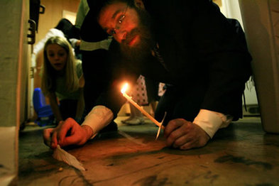
A Thought
to Ponder
The Abib 14 Festival Day is a preparation day for:
a) cleaning the home; b) removing all leaven; c) preparing the Passover meal with unleavened bread.

Slide 88
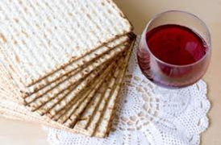
General
Order of Events:
The 14th day of the 1st month is the Passover – all 24 hours of it. After all other Passover preparations
were completed for the day, the Israelites prepared to kill the lamb “between the evenings” to eat after dusk!

